Slide 1
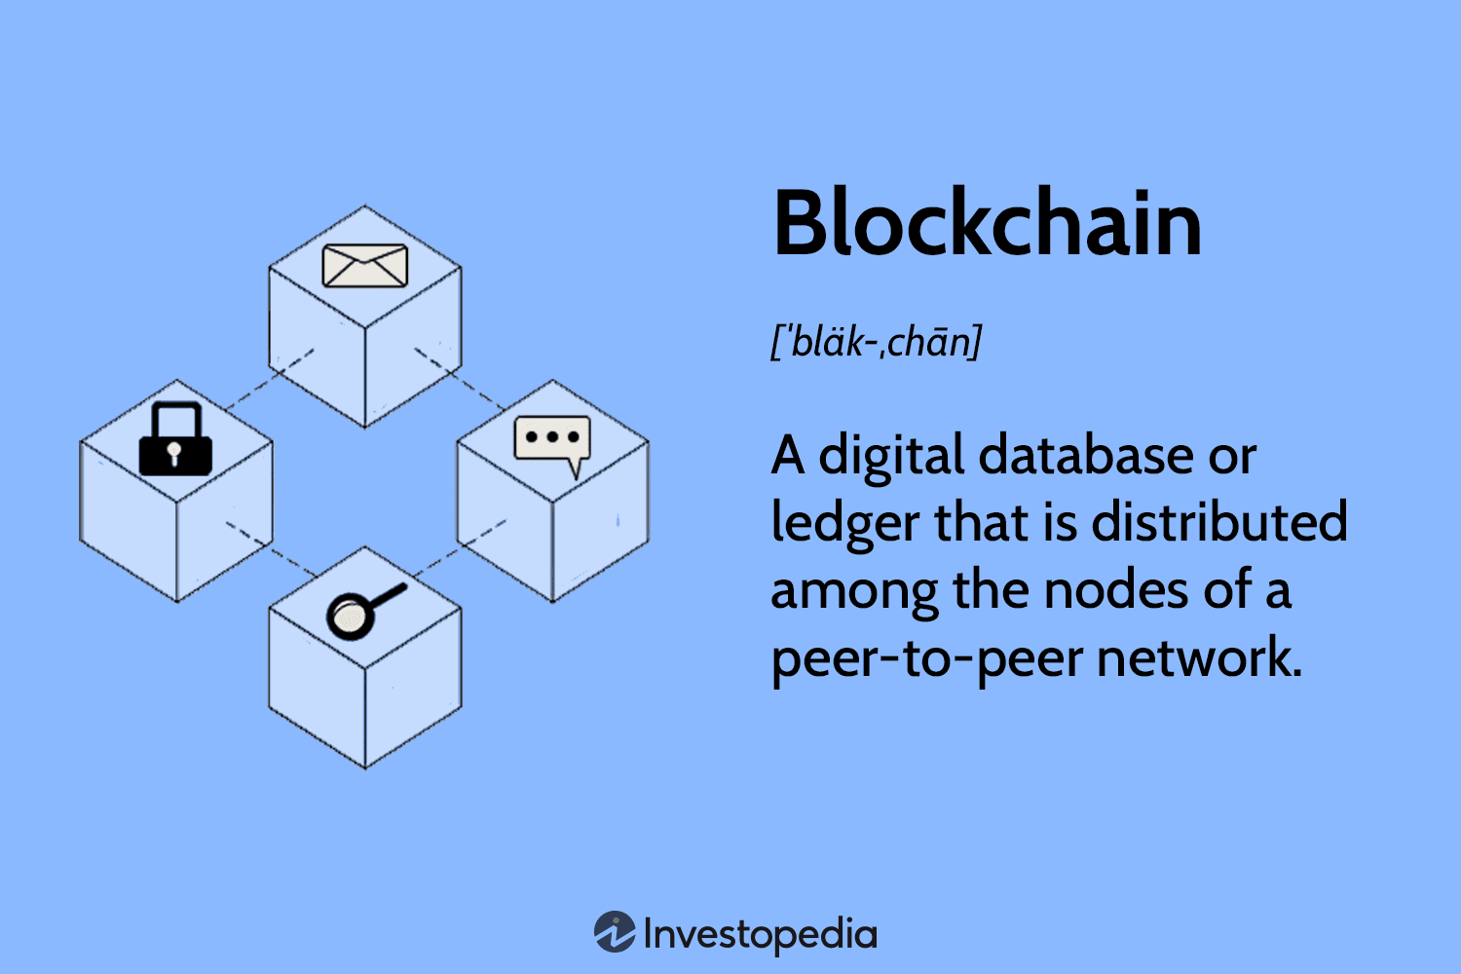
Blockchain 101
Blockchain is a decentralized digital ledger that records transactions across multiple computers. It provides transparency, security, and immutability. However, as blockchain networks grow, scalability becomes a challenge, leading to slower transactions and higher costs. Layer 2 solutions are technologies built on top of existing blockchains, like Ethereum, to address these scalability issues. They offer more efficient and cost-effective ways to process transactions, enabling faster speeds and lower fees while maintaining the security benefits of the underlying blockchain.

Slide 2
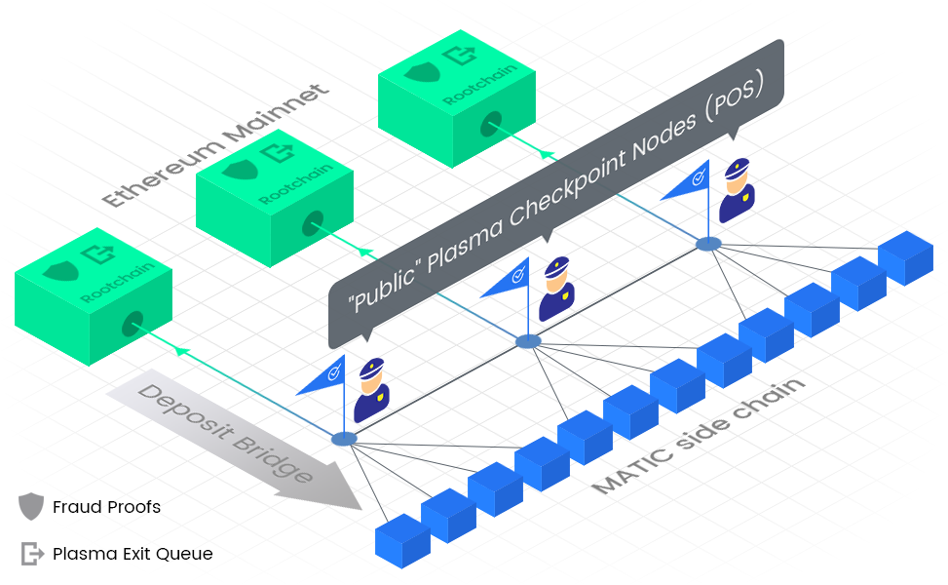
Polygon - Architecture
Within Polygon's architecture, its proof-of-stake sidechain utilizes different layers to harness the capabilities of Ethereum effectively:
Bor: This layer is responsible for producing blocks within the Polygon network. It is compatible with the Ethereum Virtual Machine (EVM) and serves as the foundation for processing and grouping transactions into blocks.

Slide 3
Polygon - Architecture
Within Polygon's architecture, its proof-of-stake sidechain utilizes different layers to harness the capabilities of Ethereum effectively:
Heimdall: As a crucial layer, Heimdall performs validator and checkpointing functions within Polygon. It consolidates blocks generated by Bor, grouping them into checkpoints. Heimdall then creates a lightweight hash of these checkpoints and publishes them to the Ethereum mainnet.

Slide 4
Polygon - Architecture
Within Polygon's architecture, its proof-of-stake sidechain utilizes different layers to harness the capabilities of Ethereum effectively:
Smart Contracts: Smart Contracts on Ethereum Mainnet: Polygon's architecture includes a set of smart contracts deployed on the Ethereum mainnet. These contracts serve important purposes such as facilitating staking of Polygon's native MATIC token and establishing checkpoints.

Slide 5
Polygon - Architecture
In summary, Polygon's architecture empowers users to stake MATIC tokens on the Ethereum mainnet. These stakers actively participate in the validation process of the Polygon Network. The Bor layer efficiently groups transactions into blocks, while the Heimdall layer further consolidates these blocks into checkpoints. Finally, Heimdall publishes a condensed representation of these checkpoints to the Ethereum mainnet, ensuring the network's integrity and reliability.

Slide 6
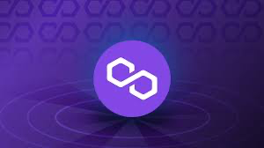
Polygon - Architecture
Polygon achieves its speed and cost-effectiveness through a clever mechanism called selective validation and checkpointing. Let's explore how this works in a more educational and engaging manner:
Imagine a bustling validator community, all working together to process blocks and validate transactions within Polygon. However, if each validator had to validate every single block, the process would be sluggish and resource-intensive, leading to delays and higher costs. That's where Polygon's selective validation approach comes into play.
Polygon carefully selects a smaller subset of validators from its vibrant community. These chosen validators collaborate and produce blocks for a specific time period, ensuring efficient and swift processing. Once their time is up, a new subset of validators takes over, keeping the network running smoothly in a continuous rotation.

Slide 7
Polygon - Architecture
To fortify the security of the network, checkpoints play a crucial role. The Heimdall layer, a vital component within Polygon, takes charge of validating a group of blocks produced by the selected validators in the Bor layer. It then creates a unique hash, like a condensed summary, representing this group of blocks. This hash is then securely sent to a smart contract deployed on the Ethereum mainnet.
Here's where Ethereum serves as a valuable backup hard drive for Polygon's state. By leveraging Ethereum's established security and robustness, Polygon ensures the integrity of its operations. If, at any point, a validator within the network acts maliciously, their staked MATIC tokens on the Ethereum mainnet are slashed, resulting in a significant financial loss for them. This strong economic deterrent maintains the trust and reliability of the Polygon network.
In this ingenious way, Polygon combines the advantages of Ethereum's security and stability without burdening every single transaction with the full weight of Ethereum's validation process. By staking and checkpointing on Ethereum, Polygon achieves a balance between efficiency and security, allowing for faster, more cost-effective transactions while ensuring the overall integrity of the network.

